Slide 1
8:45 – 9:00 | 30 MINS | 15 MINS | 15 MINS | 1 HOUR |  | PM
M | READING - CHAPTER 4 | GRAMMAR WHAT IS A DETERMINER? VIDEO https://teachers.thenational.academy/lessons/to-develop-our-knowledge-of-determiners-6gr6cr?from_query=determiners |  | PERSUASIVE LANGUAGE | MATHS Efficient Multiplication | SCIENCE What are Insulators and Conductors? https://classroom.thenational.academy/lessons/what-are-insulators-and-conductors-6rtp8t | PRODIGY
T | READING - QUESTIONS | SPELLING | DETERMINER SHEET | PERSUASIVE LANGUAGE | MATHS Written Methods | 1.MUSIC - watch the video 2. FRENCH - Food. Watch the video | TT ROCKSTARS
W | READING – START CHAPTER 5 | SPELLING - | DETERMINER SHEET | PERSUASIVE LANGUAGE | MATHS Multiply 2 digits by 1 digit | GREEK PROJECT WORK PE – CONTINUE WITH I AM A CELEBRITY PPT | PRODIGY
T | READING – FINISH CHAPTER 5 | SPELLING | DETERMINER SHEET | PERSUASIVE LANGUAGE | MATHS Multiply 2 digits by 1 digit | GEOG /HISTORY Record historical information about the Iroquois tribe. | TT ROCKSTARS
F | READING SKILLS SHEET - | SPELLINGS WATCH THE VIDEO https://classroom.thenational.academy/lessons/to-practise-curriculum-words-6tj32d?activity=video&step=1 |  | PERSUASIVE LANGUAGE | MATHS Multiply 3 digits by 1 digit | DT Prepare and cook a traditional US dish | PRODIGY

Slide 3

25.1.21 READING

Slide 7
25.1.21 GRAMMAR - DETERMINERS
https://teachers.thenational.academy/lessons/to-develop-our-knowledge-of-determiners-6gr6cr?from_query=determiners
Can you write a simple explanation telling us what a determiner is now you have watched the video?
Or record an explanation and post it to your teacher on Seesaw.
A determiner is …...

Slide 8
25.1.21. GETTING READY TO WRITE
We are going to be writing an advert for a travel agent this week. They want to encourage people to travel to New York.
Click on the link below or type it into your browser and watch the teaching video about the features of adverts.
https://classroom.thenational.academy/lessons/to-understand-the-features-of-adverts-65k3ed
Using the ideas from the video (DON'T WORRY THAT IT WAS ABOUT HEALTHY SNACKS. WE WILL APPLY THOSE SKILLS TO OUR TASK) can you write down some sentences comparing New York with another holiday destination or stating why a person should visit there?
Eg. Travel to New York this summer as it has more exciting places to explore than any other city in the world!
New York's Central Park has the most beautiful flowers and the widest range of plants.
Look back to last week's work and the poster you created on Friday to help you. It doesn't matter though if it isn't entirely true!

Slide 9
25.1.21. WRITE YOUR SENTENCES HERE
1.
2.
3.
4.
5.

Slide 10
Monday 25th January
Maths
Efficient Multiplication

Slide 11
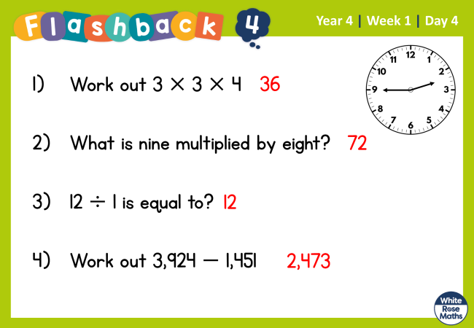





Slide 12
Watch the video.
https://vimeo.com/492101020

Slide 13
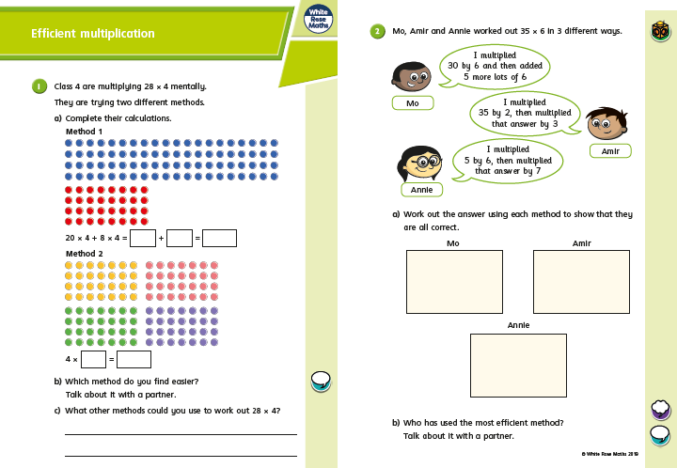

Slide 14
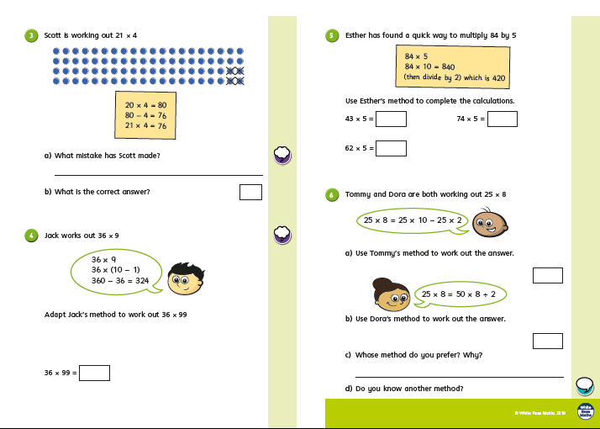

Slide 15
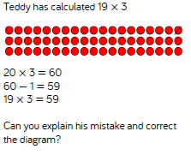

Slide 16
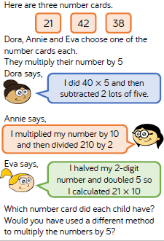

Slide 17
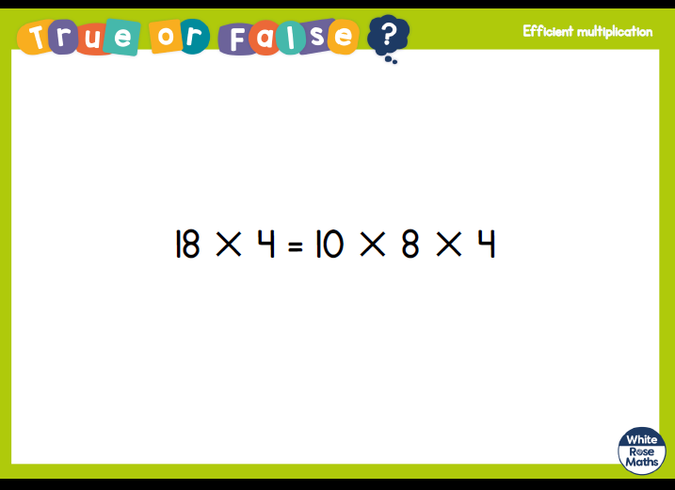

Slide 18
Monday 25th January
Science
What are Insulators and Conductors?
https://classroom.thenational.academy/lessons/what-are-insulators-and-conductors-6rtp8t

