Slide 1
SPAG Wednesday 3rd March 2021 WALT:
To develop a rich understanding of words associated with meals (thenational.academy)

Slide 2
English Wednesday 3rd March 2021 WALT: Design a healthy snack.
To design a healthy snack (thenational.academy)

Slide 3
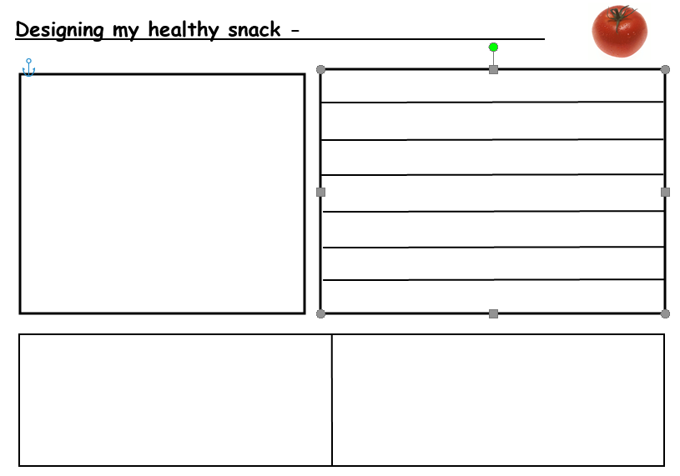

Slide 4
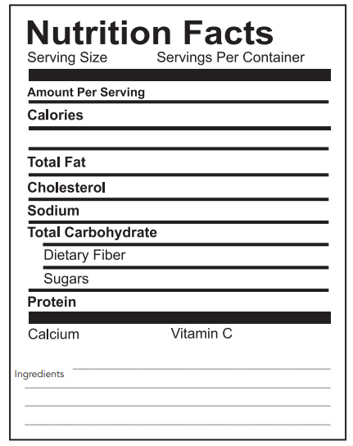

Slide 5
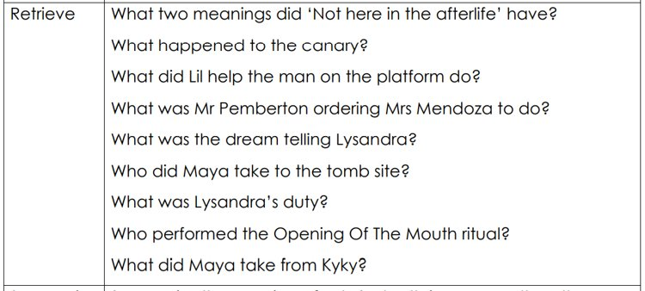
Reading Wednesday 3rd March 2021 WALT:
Chapter 12 and 13

Slide 6
WEDNESDAY 3.3.21 – ALL HOME LEARNING
MATHS
Watch the video and complete the worksheets. https://vimeo.com/498327611
CHALLENGE 1 –QUESTIONS 1-3
CHALLENGE 2-QUESTIONS 4-6
CHALLENGE 3 –QUESTIONS 7-9

Slide 7
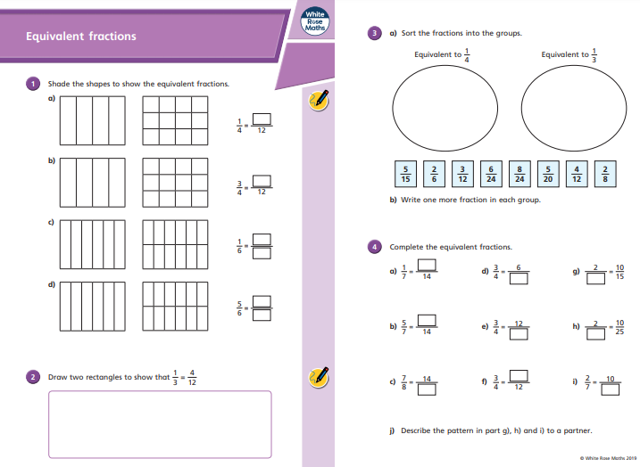
CH 1
CH 2

Slide 8
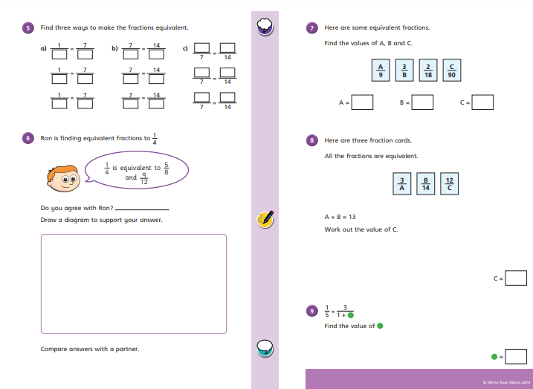
CH 3

